Slide 1

Finding the data: Indigenous Peoples
This Photo by Unknown author is licensed under CC BY-SA.
Presenters: Kayla Lar-Son
April 28th, 2021

Slide 2
Welcome
We acknowledge we are on the unceded territories of the xʷməθkʷəy̓əm (Musqueam), Sḵwx̱wú7mesh (Squamish), and Sel̓íl̓witulh (Tsleil-Waututh) Nations. We thank them for having cared for these lands and waters since time immemorial and we thank them for allowing us to work, live, and thrive on these lands as uninvited guests.

Slide 3
Outline
Context
Indigenous Data
Issues with Indigenous Knowledge and Data Protection
Indigenous Data Soveriegnty
Questions/discussion
Statistics Canada Data sources
Accessing Statistics Canada Microdata
Questions/discussion

Slide 4
Indigenous Sovereignty in Canada
Indigenous Self Governance
Canada recognizes that Indigenous peoples have an inherent right of self-government guaranteed in section 35 of the Constitution Act, 1982. As well the Government of Canada recognizes that Indigenous peoples have the inherent right to self-govern and this right can be expressed through treaties, and in the context of the Crown's relationship with treaty First Nations. Recognition of the inherent right is based on the view that Indigenous peoples in Canada have the right to govern themselves in relation to matters that are internal to their communities, integral to their unique cultures, identities, traditions, languages and institutions, and with respect to their special relationship to their land and their resources.

Slide 5


UNDRIP
“Indigenous people have the right to maintain, control, protect and develop their cultural heritage, traditional knowledge and traditional cultural expressions….
They also have the right to maintain, control and protect and develop their intellectual property over such cultural heritage, traditional knowledge and traditional cultural expressions (p. 11)”

Slide 6
Indigenous Knowledges
Traditional Knowledges (TK) are Knowledges, know-how, skills and practices that are developed, sustained and passed on from generation to generation within a community, often forming part of its cultural or spiritual identity (WIPO, 2020).
There is no universally accepted definition of TK but in general it can be said that;
TK in a general sense embraces the content of Knowledge itself as well as traditional cultural expressions, including distinctive signs and symbols associated with TK.
TK in the narrow sense refers to Knowledges as such, in particular the Knowledges resulting from intellectual activity in a traditional context, and includes know-how, practices, skills, and innovations.

Slide 7
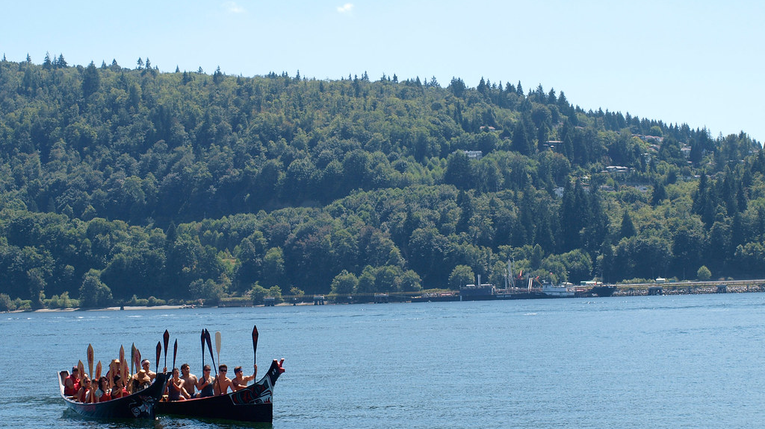
Indigenous Data
This Photo by Unknown author is licensed under CC BY-SA-NC.

Slide 8
What Does Indigenous Data Look Like?
Data on Indigenous resources/environments
Data about Indigenous demographics or social data
Data from Indigenous communities
Legal
Health
Education
Service use
Includes community produced data
•Traditional and cultural data
•Archival
•Oral traditions
•Reordered oral traditions
•Ancestral Knowledge
•Community stories
Land history
Geological information
Titles
Water information

Slide 9
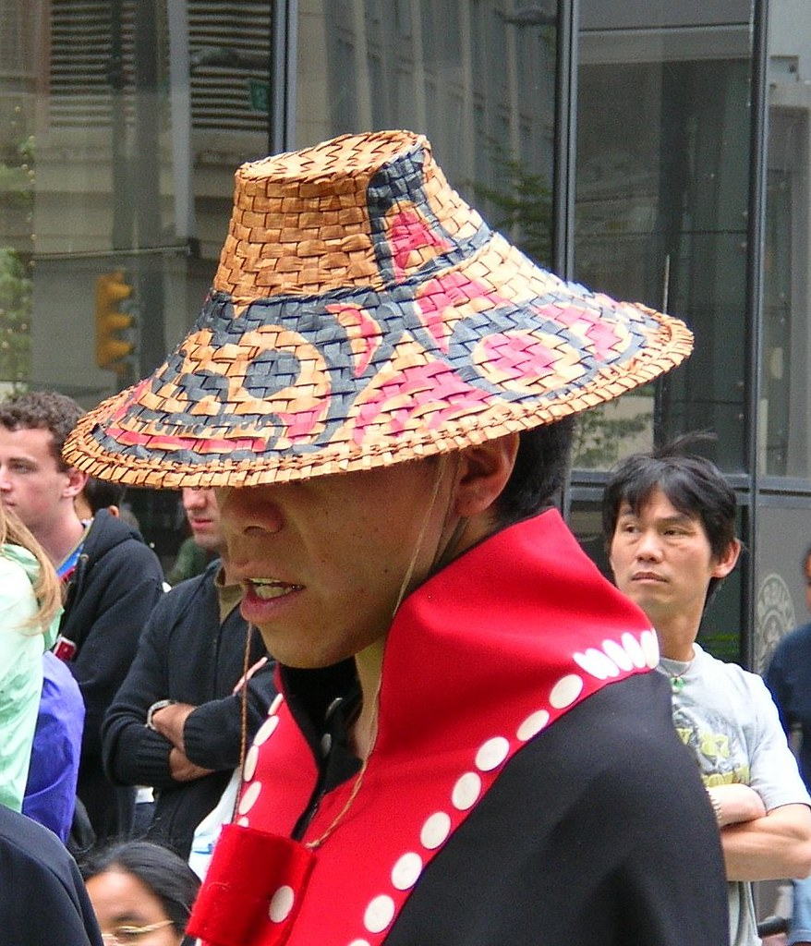
Indigenous Cultural Expressions
Music
Dance
Art
Designs
Names
Signs & Symbols
Performances
Ceremonies
Architectural forms
Crafts
Narratives
(WIPO, 2020)
This Photo by Unknown author is licensed under CC BY-NC-ND.

Slide 10

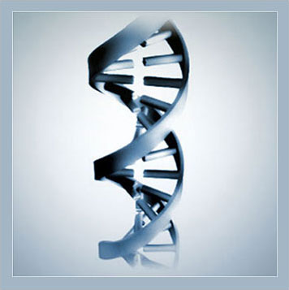
Genetic Resources
Genetic and other biological resources constitute unique subject matter for IP protection ever since IP systems began to protect innovation in the modern life sciences, as early as the mid1970s. They include, for example, microorganisms, plant varieties, animal breeds, genetic sequences, nucleotide and amino acid sequence information, traits, molecular events, plasmids, and vectors (WIPO, 2020).
This Photo by Unknown author is licensed under CC BY-SA.

Slide 11
Indigenous Data Protocols
Ownership and Inheritance – community, individual, clan, families
Earned
Age
Gender identity
Geography
Season
Techniques – art, harvesting
-These protocols can use collective Knowledges, and follow Indigenous Laws

Slide 12
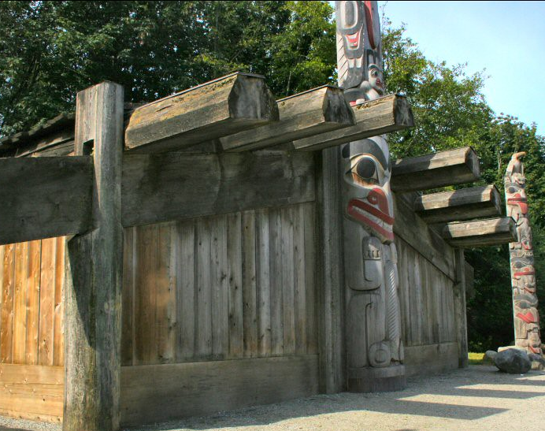
Issues with Indigenous Knowledge and Data Protection (IKP)
This Photo by Unknown author is licensed under CC BY.

Slide 13
Indigenous Research
Historically Indigenous research and data collection was done with problematic practices. There was a lack of Indigenous community control of the way that research and data was conducted and where the data will be disseminated, stored, and destroyed.
Research and data collection in Indigenous communities has also been (and arguably continues to be) deficit based and dismisses narratives of resilience.
*For example - Documenting and examining trauma, pain and loss in research and not respecting the topic you’re discussing, or the community members who have lived the experiences.

Slide 14
Contd.
Younging, 2010, p.10 - Issues with IPR and its imposition on TK and Indigenous communities
expressions of TK often cannot qualify for protection because they are too old and are, therefore, supposedly in the Public Domain;
that the “author” of the material is often not identifiable and there is thus no “rights holder” in the usual sense of the term; and
that TK is owned “collectively” by Indigenous groups for cultural claims and not by individuals or corporations for economic claims.

Slide 15
Copyright & Indigenous Knowledge Sovereignty in a Canadian Context
Canadian laws, have worked not only to ignore and/or specifically deny the rights of Indigenous peoples to practise and maintain their cultural and intellectual property but also to legalize the theft of Indigenous cultural and intellectual property through the Copyright Act.
However the Canadian Government does recognize issues around Canadian copyright - Introduction to Intellectual Property Rights and the Protection of Indigenous Knowledge and Cultural Expressions in Canada.

Slide 16
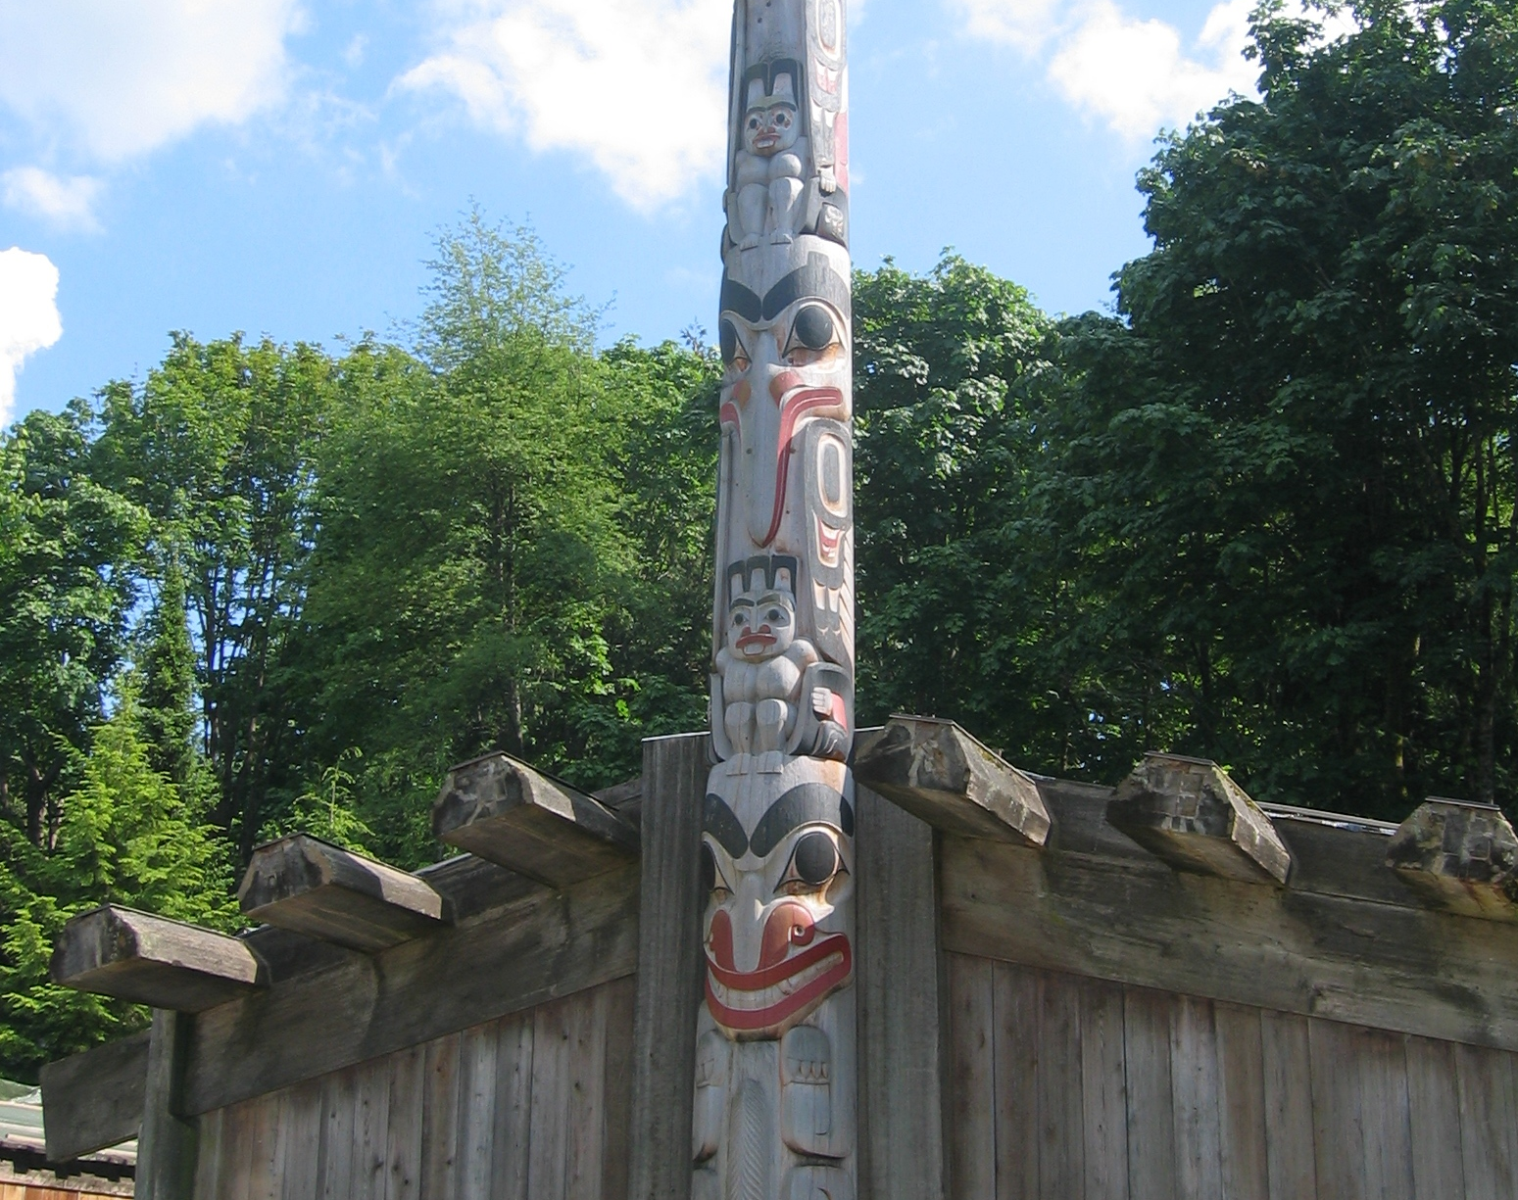
Data = Power Power = Control Control = Hierarchy and Access
This Photo by Unknown author is licensed under CC BY-SA.

Slide 17
Indigenous Data Sovereignty
Indigenous nations have the right to ownership and governance over data about them, regardless of where it is held and by whom;
Indigenous Peoples also have the right to access data that supports nation re-building. This often includes access to government documents/historic and contemporary and archival documents.

Slide 18
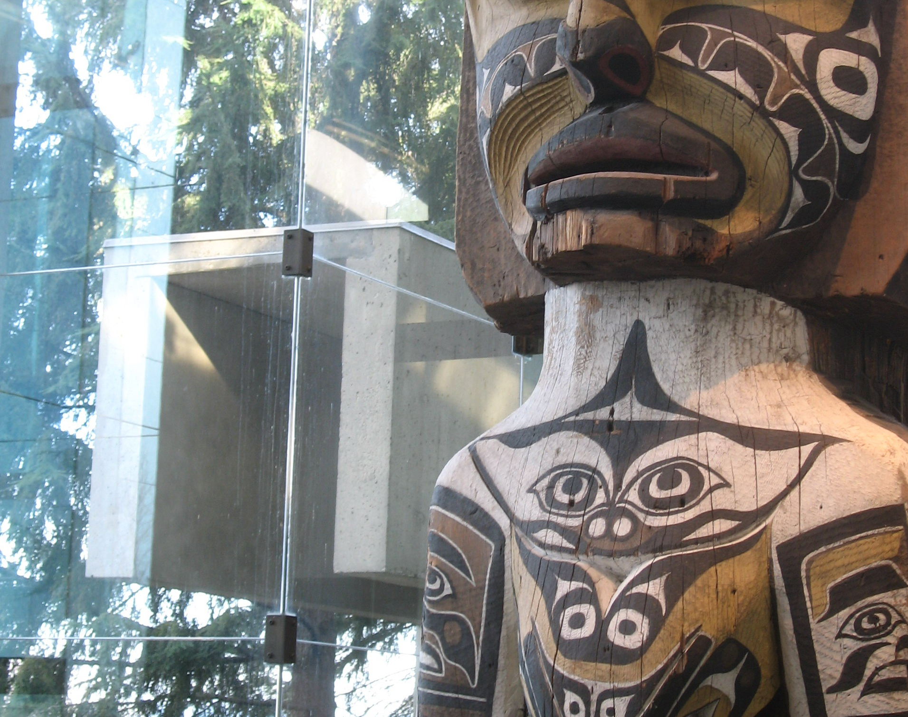
Authenticity
This is tricky, but in general it is up to the community that the information or the cultural practice that is in question to verify
This Photo by Unknown author is licensed under CC BY-SA.

Slide 19
Finding Indigenous Voices in Research
Look for wording or statements about community evolvement – this includes acknowledgement of Free, Prior, and Informed Consent.
Is there recognition of community as being a crucial part of the research process? Is the community identified as an active participant in the research?
Identify community driven wording such as community lead
Is there any recognition of Indigenous ownership of Information?
How old is the research or what is the age of the documents that you are working with (example: archival documents)

Slide 20
Finding Indigenous Data from Indigenous Sources
Check community websites – Consult with their own heritage or research departments.
Look for community produced reports, monographs, and ephemera
FNIGC - https://fnigc.ca/first-nations-data-centre/.

Slide 21
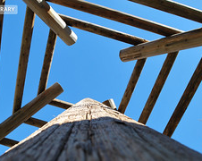
Finding Help at UBC
IRSI - https://irsi.ubc.ca/
Xwi7xwa Library - https://xwi7xwa.library.ubc.ca/contacts/.
UBC Libraries - https://directory.library.ubc.ca/subjectlibrarians/
Research Commons - https://researchcommons.library.ubc.ca/
REB - https://ethics.research.ubc.ca/
UBC Copyright Office - https://copyright.ubc.ca/
UBC ISP - https://indigenous.ubc.ca/indigenous-engagement/indigenous-strategic-plan/. (Goal 3)
This Photo by Unknown author is licensed under CC BY-NC-ND.

Slide 22
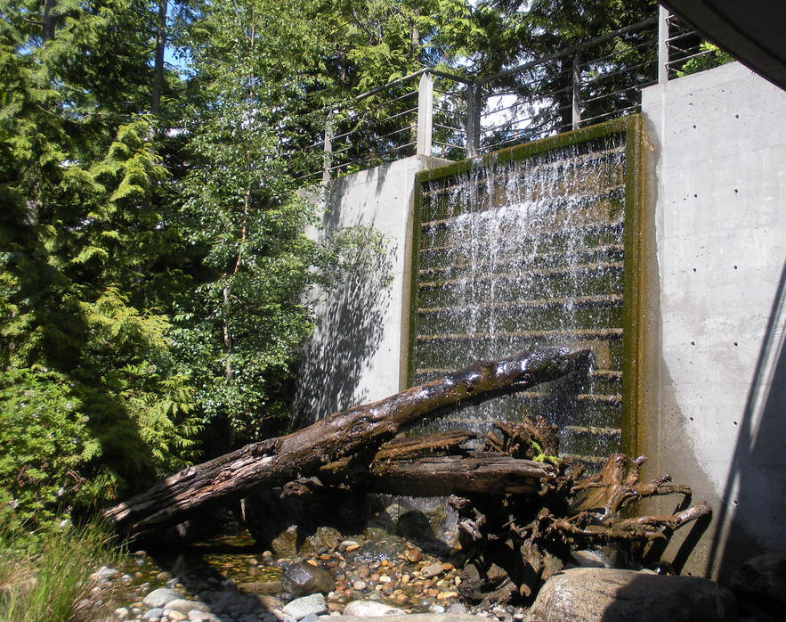
Indigneous Data Principles and Organizations – Beyond UBC
OCAP https://fnigc.ca/ocap-training/.
GIDA https://www.gida-global.org/.
WIPO https://www.wipo.int/tk/en/.
Murkutu https://mukurtu.org/.
Local Context https://localcontexts.org/.
This Photo by Unknown author is licensed under CC BY-NC.

Slide 23
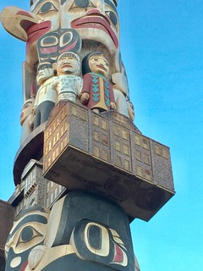
Contact
Kayla.lar-son@ubc.ca
This Photo by Unknown author is licensed under CC BY-NC.

